Slide 1



EEE316 – MICROPROCESSORS PROJECT
TUĞBA BAŞ
180403017

Slide 2
ELEVATOR FEATURES
While we were designing , we added some features that we think will add features and show the difference among its competitors as well as the basic elevator principles . We are of the opinion that our elevator is the app that we made the most striking scan.
1
MUSIC PLAYER
2
ENTRYPHONE
We added a music player button in order to reduce the level of tension that narrow spaces can create in the use of the product and to change the mood in a positive way.
We have added an intercom, which we think is of high importance, as it will enable the user to communicate with the outside to solve the problem in unidentified power cuts and prevent sudden cardiac arrests due to high fear.
3
COUNTER
4
ANDROID APP
In order to avoid any disruption in hardware failure, we have developed our counter that will provide a visual warning statement to the user with an LCD display of the number of people entering.
In addition to providing remote access to the product and its features by using the remote access module. With the Tic Tac Toe game, which will increase its functionality and shorten waiting times, we have made our application enjoyable for non-elevator uses.

Slide 3

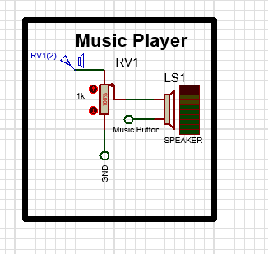

Part One:MUSIC PLAYER
We added a music player button to reduce the tension that narrow spaces can create in the use of the product and to change the mood in a positive way. In order to give the user a Flying Impression we initially set fly me to the Moon song.

Slide 4
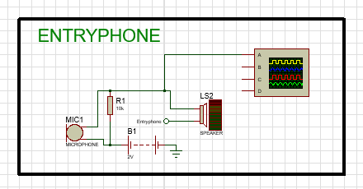
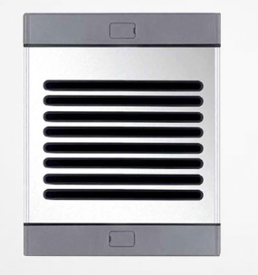
PART TWO: ENTRYPHONE
“ Safety comes first ”
80%
Impression Fly
Considering the principle of 'Safety comes first', which is always in our minds in our product design and guides our developments, we designed an intercom, which we believe can provide both psychological and technical support by communicating with the outside. We are in the first place in voice transmission with our bandwidth that has increased to 80%.

Slide 5
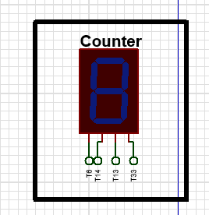
PART THREE: COUNTER
Impression Fly
In addition to showing the user with LCD screens that our product has a person-based limitation, we aimed to prevent possible mechanical deterioration by adding a counter that changes depending on our pressure sensors. As in the icon mentioned above, we set our User number to three.

Slide 6
PART FOUR : ELEVATOR APP
A
Ease of remote access between floors. The opportunity to feel all the features of the product in the palm of your hand.
B
Music player and game service that provides free psychological affirmation (TIC TAC TOE).
C
Video product promotion with our principle based on the principle of "Never lose contact with the user".Remote module connection controller.

Slide 7
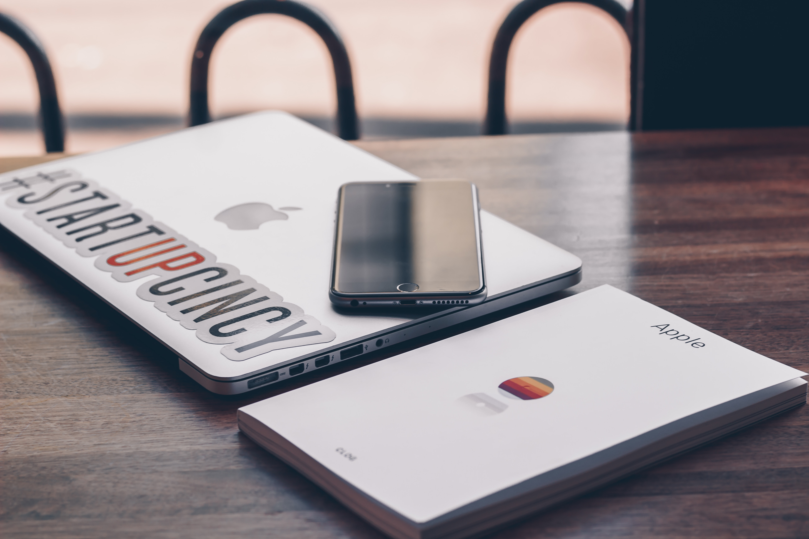
Possibility to quickly switch between the game page and menu pages.
Quick access to Youtube music page with button.

Slide 8
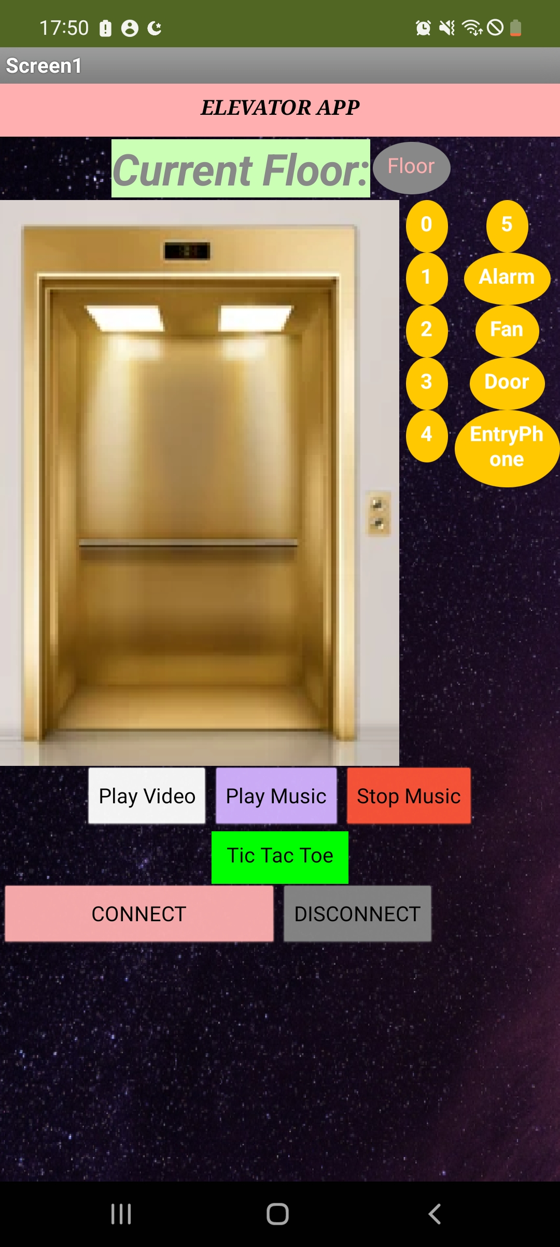
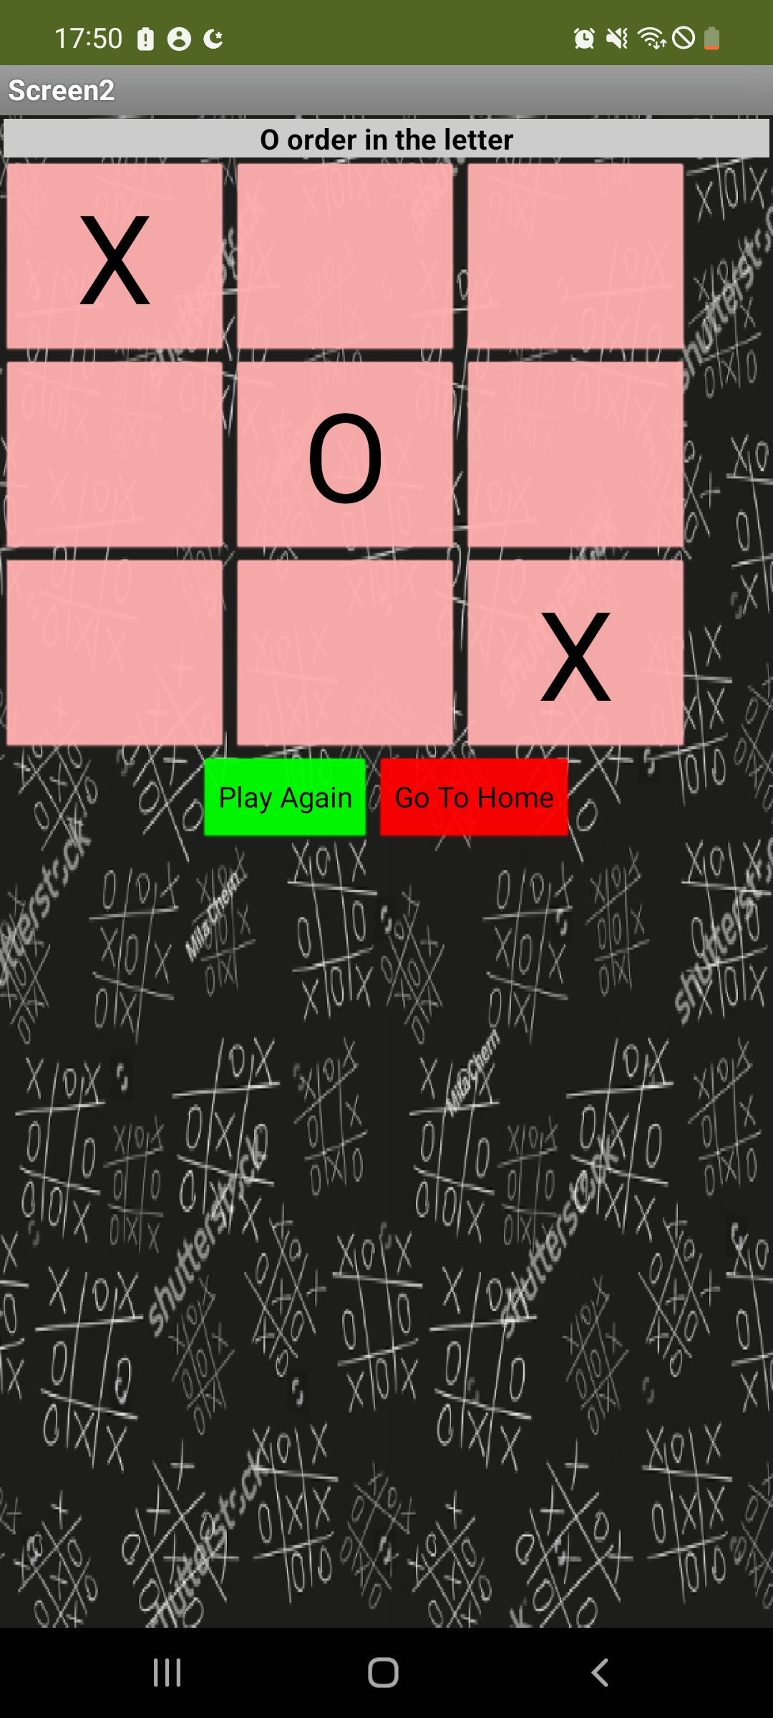
APP LAUNCH DESIGN

Slide 9
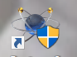


TEAM MATES
PRODUCTION TEAM
CODE TEAM
DESIGN TEAM
PROTEUS
MICRO C Pro for PIC
MIT APP INVENTOR
Thank to Proteus Company to provide me to create a Circuit Design.
Thank Micro C company to provide me with a coding environment
Thank MIT App Inventor company to provide me a design environment

Slide 10
ELEVATOR PROJECT
Thank You For Listening
TUĞBA BAŞ
180403017

